Slide 1

Demand Paging, Page Replacement Algorithms, Allocation of Frames

Slide 2
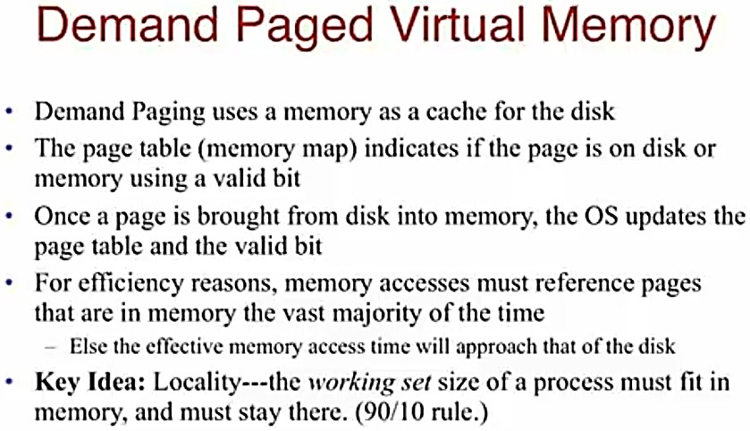



Slide 3
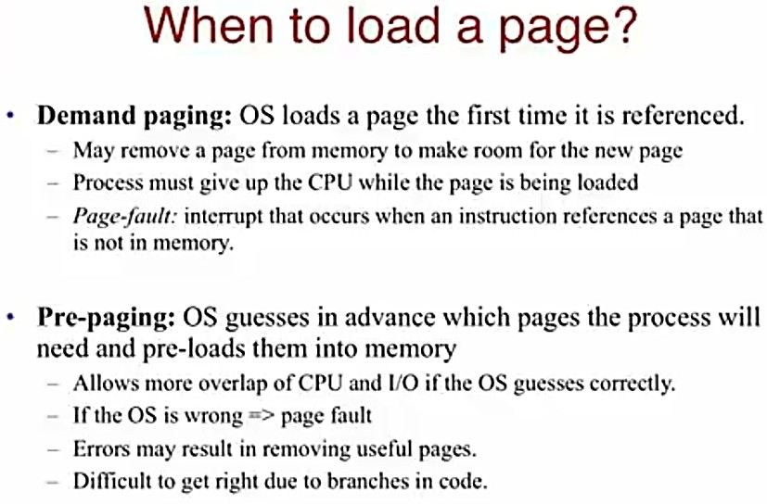



Slide 4
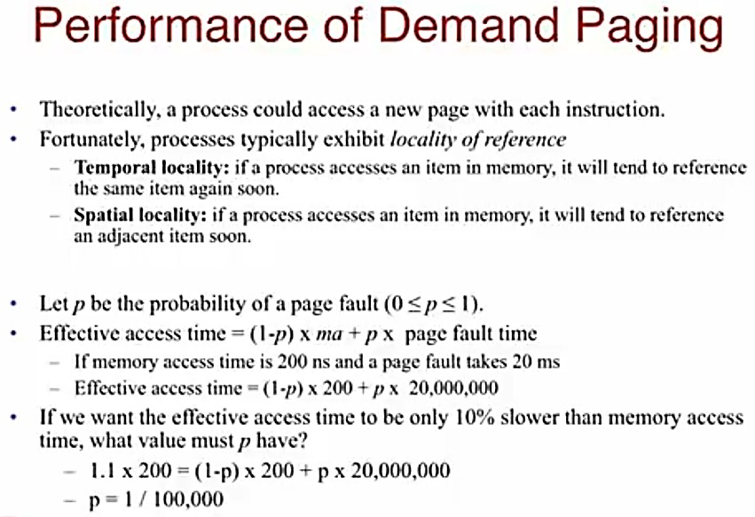

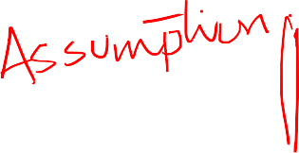
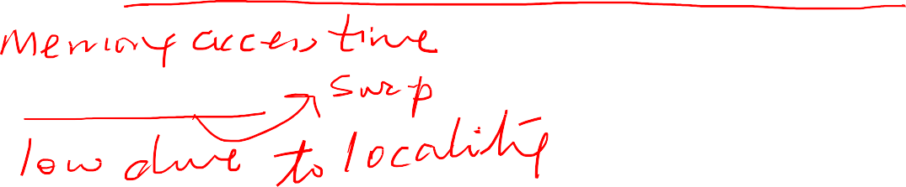
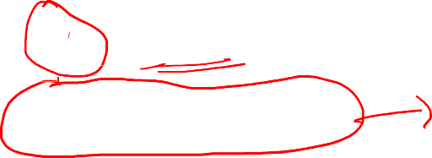





Slide 5
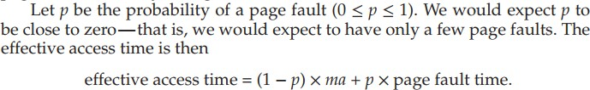

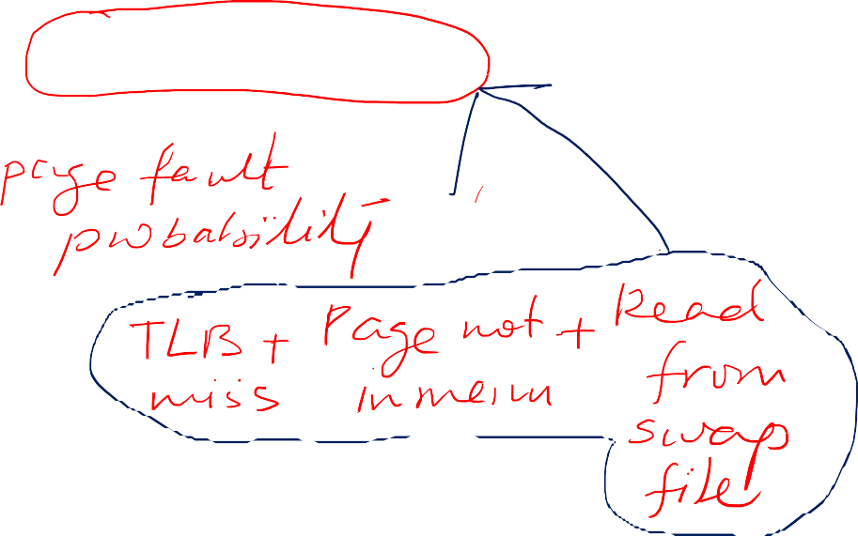










Slide 6
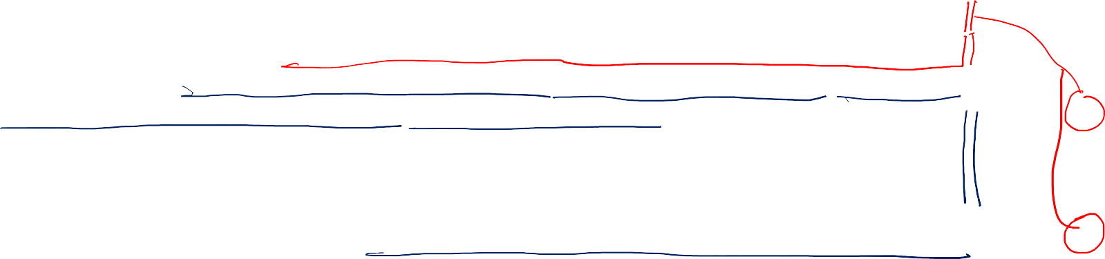
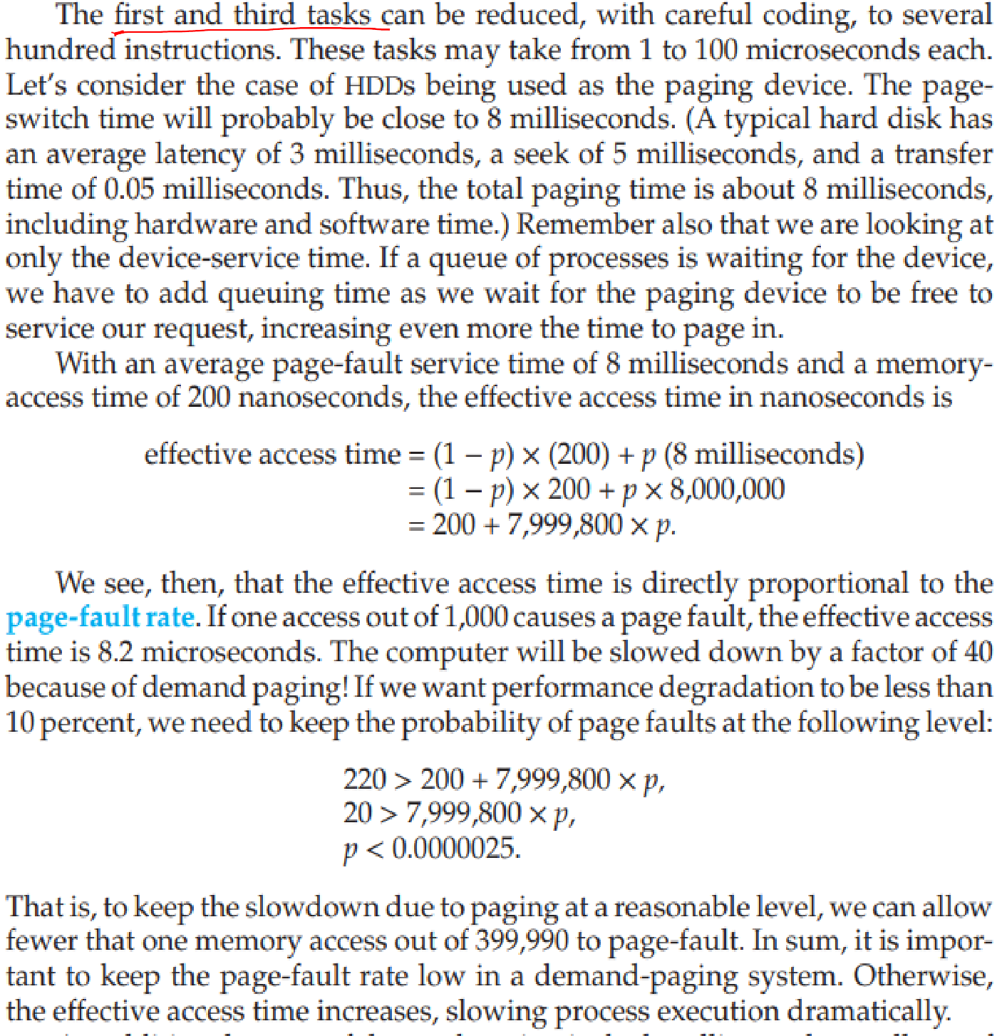
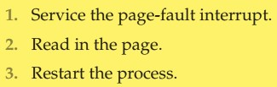







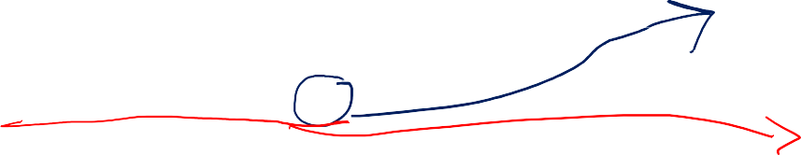
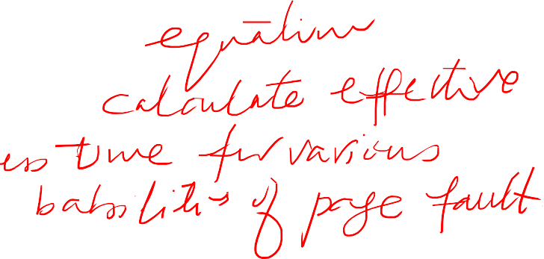



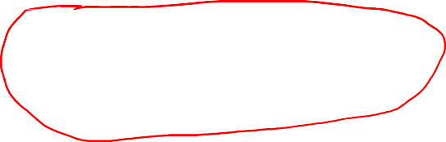


Slide 7




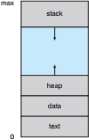










fork() system call creates a child process that is a duplicate of its parent. Traditionally, fork() worked by creating a copy of the parent’s address space for the child, duplicating the pages belonging to the parent. However, considering that many child processes invoke the exec() system call immediately after creation, the copying of the parent’s address space may be unnecessary.

Slide 8
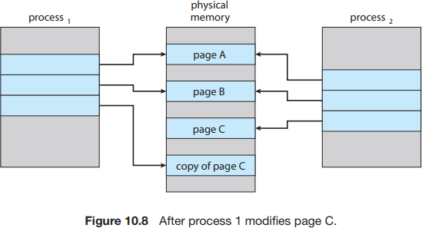
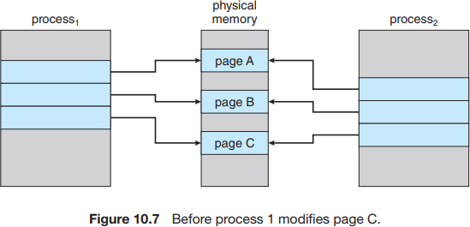
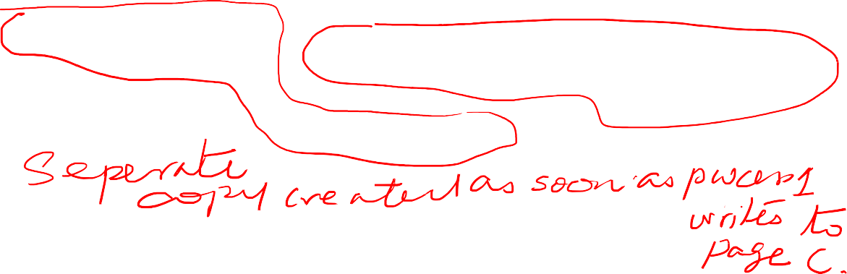


Instead, we can use a technique known as copy-on-write, which works by allowing the parent and child processes initially to share the same pages. These shared pages are marked as copy-on-write pages, meaning that if either process writes to a shared page, a copy of the shared page is created. Copy-on- write is illustrated in Figures 10.7 and 10.8, which show the contents of the physical memory before and after process 1 modifies page C.
Only pages that can be modified need be marked as copy-on-write. Pages that cannot be modified (pages containing executable code) can be shared by the parent and child. Copy-on-write is a common technique used by several operating systems, including Windows, Linux, and macOS.

Slide 9



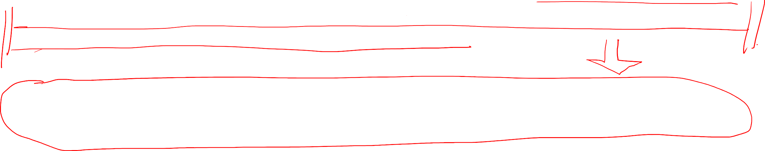
Frame Allocation vs Page Replacement
The frame allocation problem refers to the challenge of allocating limited physical memory frames among multiple processes or pages in a virtual memory system. It involves deciding how many physical memory frames to allocate to each process or page, and which frames should be allocated, to ensure efficient memory usage and minimize page faults.
The page replacement problem specifically refers to the challenge of selecting which page(s) should be evicted from physical memory when a page fault occurs and a new page needs to be brought in from disk.
The frame allocation problem deals with the initial allocation of physical memory frames to processes or pages, while the page replacement problem deals with the selection of pages to be replaced from physical memory when needed.

Slide 10
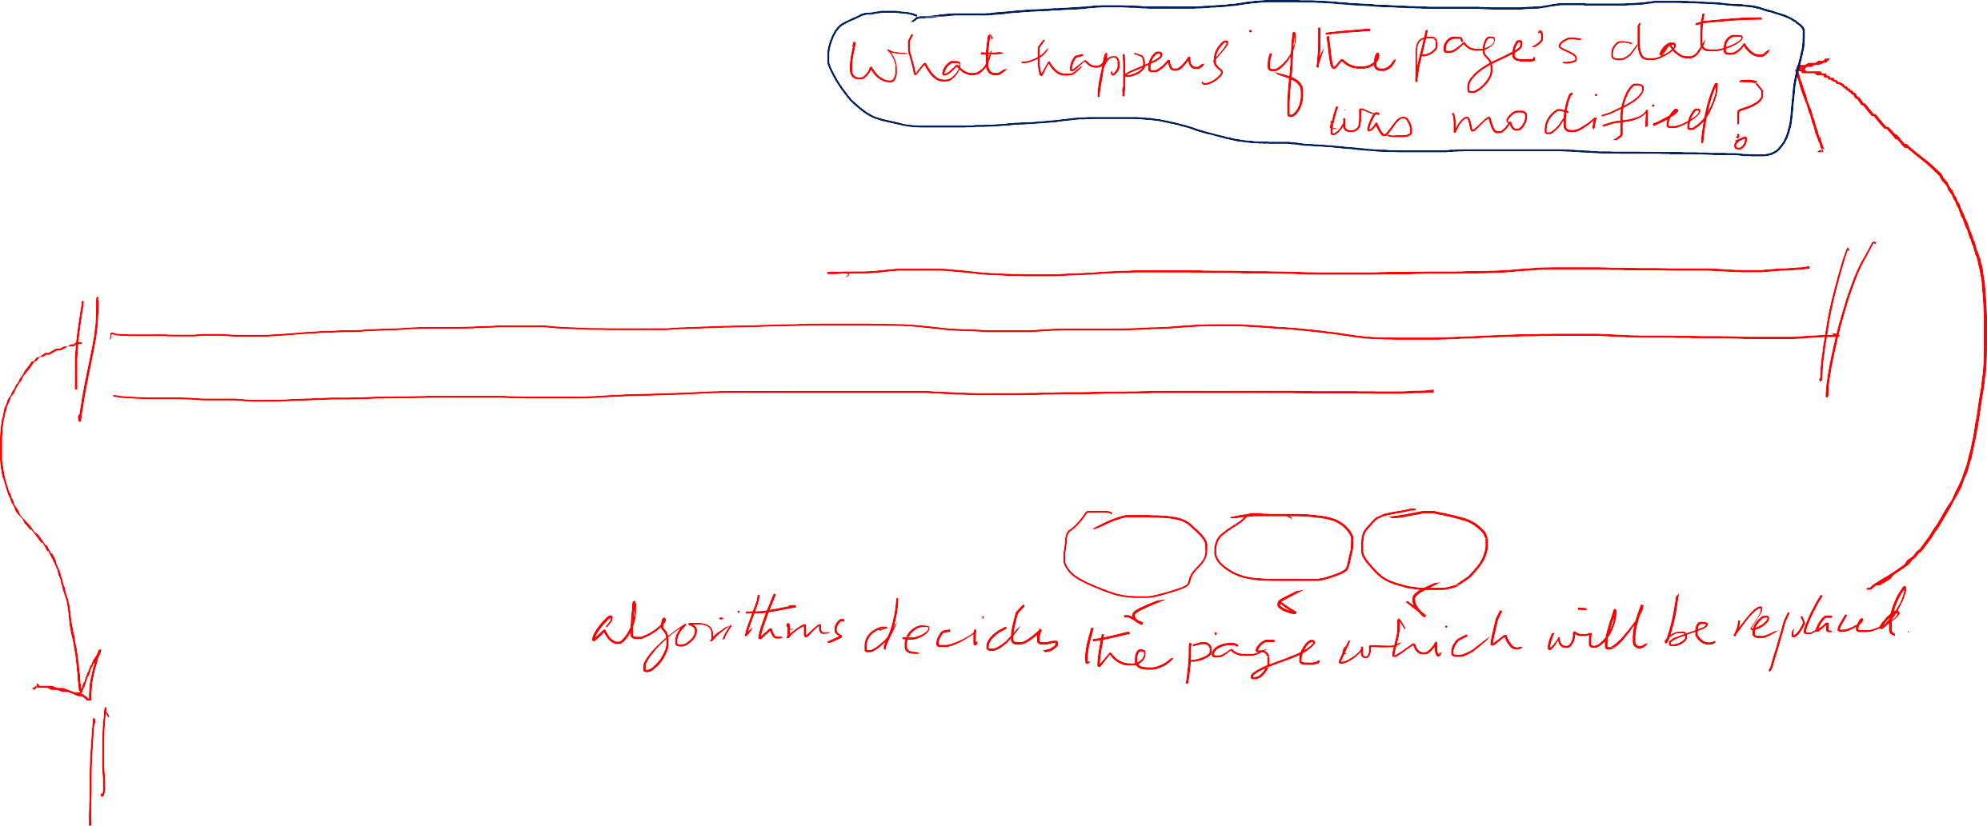










Page replacement is a mechanism used in demand paging, a virtual memory management technique, where the operating system selects a page from physical memory to be replaced with a new page from disk when there is no free memory available for a page requested by a process.
The selection of the page to be replaced is typically based on various algorithms, such as: Least Recently Used (LRU), FIFO, OPT, or Random algorithms.
The selected page is then evicted from physical memory, and the new page is loaded from disk into the vacated page frame.
It aims to optimize memory usage by efficiently managing limited physical memory resources and ensuring that the most frequently accessed pages are retained in memory, while less frequently used pages are replaced to disk.

Slide 11






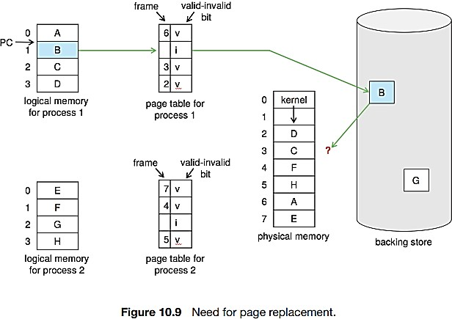

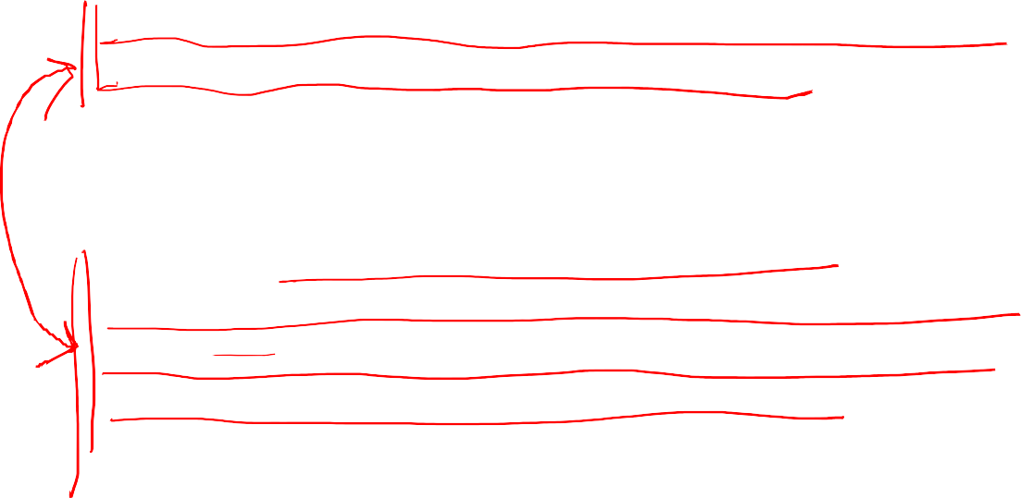

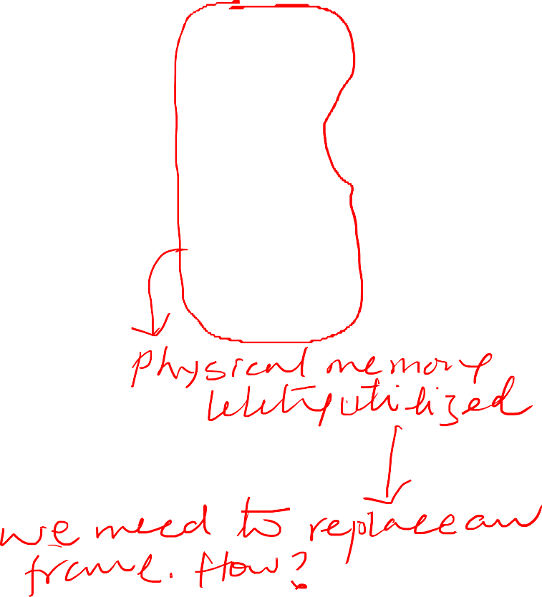
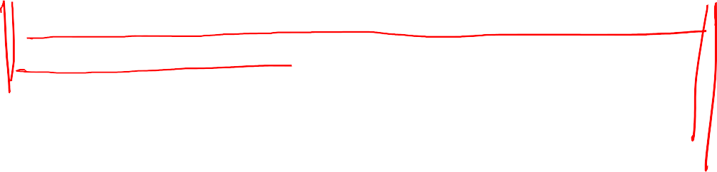



If we increase our degree of multiprogramming, we are over-allocating memory.
If we run six processes, each of which is ten pages in size but actually uses only five pages, we have higher CPU utilization and throughput, with ten frames to spare.
However, it is possible that each of these processes, for a particular data set, may suddenly try to use all ten of its pages, resulting in a need for sixty frames when only forty are available. Same scenario can happen if Buffer allocated for I/O suddenly increase.
There are no free frames on the free-frame list; all memory is in use. This situation is illustrated in Figure 10.9, where the fact that there are no free frames is depicted by a question mark.

Slide 12


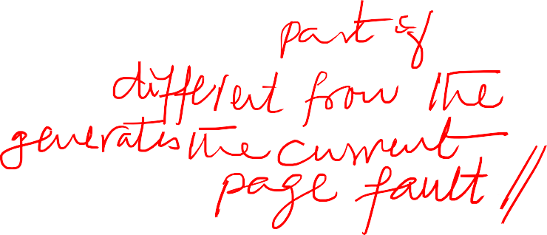










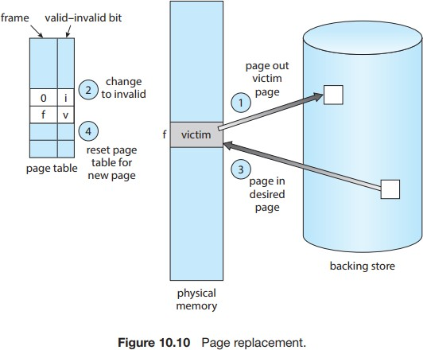


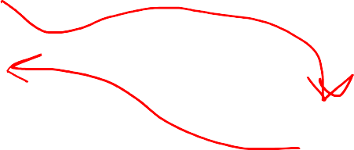



If no frame is free, we find one that is not currently being used and free it.
We can free a frame by writing its contents to swap space and changing the page table (and all other tables) to indicate that the page is no longer in memory (Figure 10.10).
We can now use the freed frame to hold the
page for which the process faulted.
Standard swapping is no longer used by most operating systems due to the overhead of copying entire processes between memory and swap space.
Most operating systems now combine swapping pages with page replacement,

Slide 13
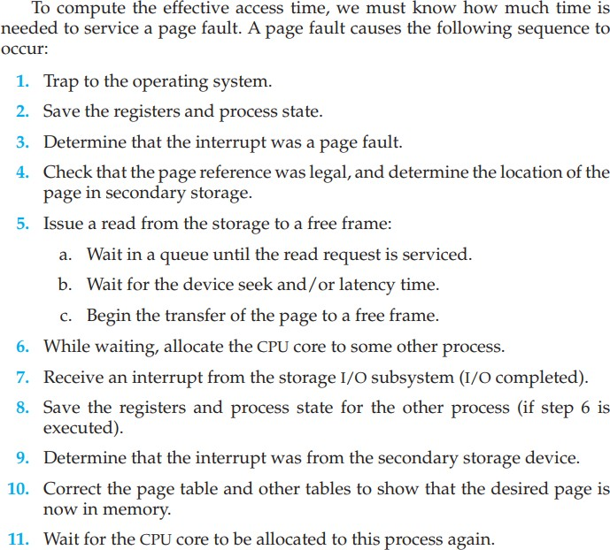





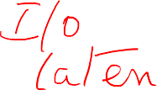

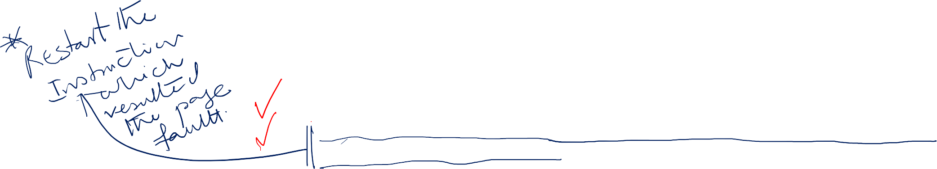


Slide 14












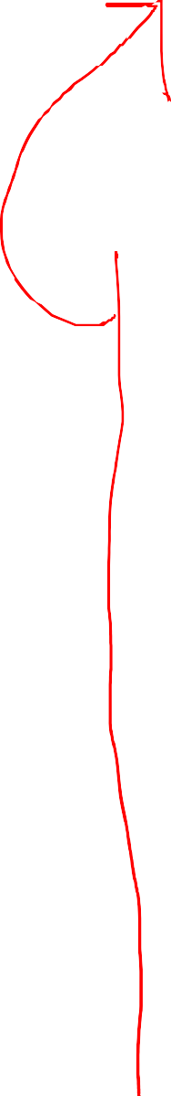

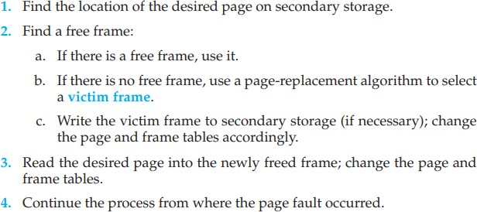
Page-fault service routine now has these additional steps with page replacement:

Slide 15
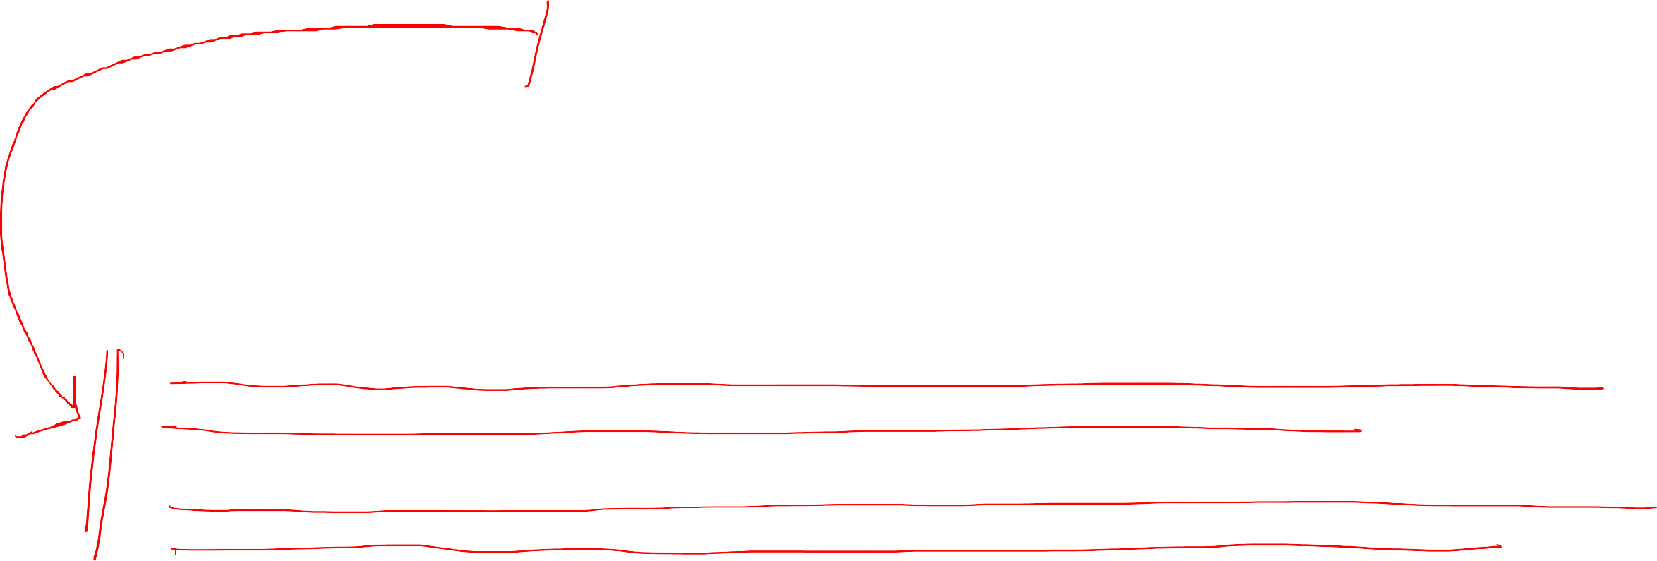





Modify bit (or dirty bit)
if no frames are free, two page transfers (one for the page-out and one for the page-in) are required. This situation effectively doubles the page-fault service time and increases the effective access time accordingly.
We can reduce this overhead by using a modify bit (or dirty bit) attached to each page or frame in the hardware.
If the modify bit for a page is set by the hardware whenever any byte in the page is written into,
indicating that the page has been modified and need to be updated to storage.
If the modify bit is not set, however, the page has not been modified (or is read-only like executable code pages) since it was read into memory. Therefore, the page can be discarded safely.
This technique also applies to read-only pages (for example, pages of binary code). Such pages cannot be modified; thus, they may be discarded when desired. This scheme can significantly reduce the time required to service a page fault, since it reduces I/O time by one-half if the page has not been modified.

Slide 16
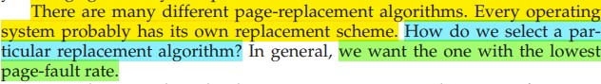






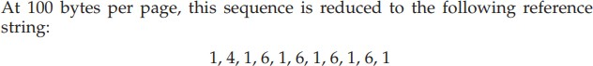
Evaluation of Page Replacement Algorithms

Slide 17
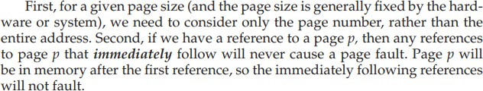
Evaluation of Page Replacement Algorithms

Slide 18



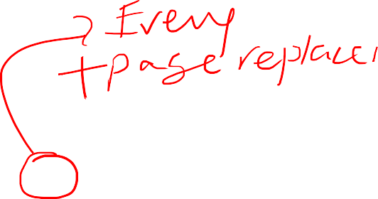
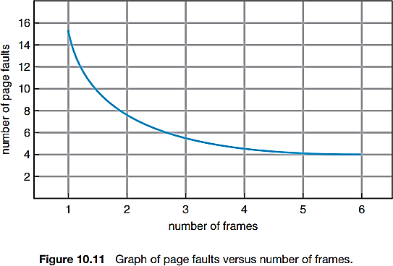



How number of available frames relates to page faults?
Reference string 1, 4, 1, 6, 1, 6, 1, 6, 1, 6, 1
For three or more frames, we would have only three faults— one fault for the first reference to each page.
If only one frame available, we would have a replacement with every reference, resulting in eleven faults.
In general, we expect a curve such as that in
Figure 10.11.
As the number of frames increases, the number of page faults drops to some minimal level. Of course, adding physical memory increases the number of frames.

Slide 19
























Introduction to Page Replacement Algorithms

Slide 20
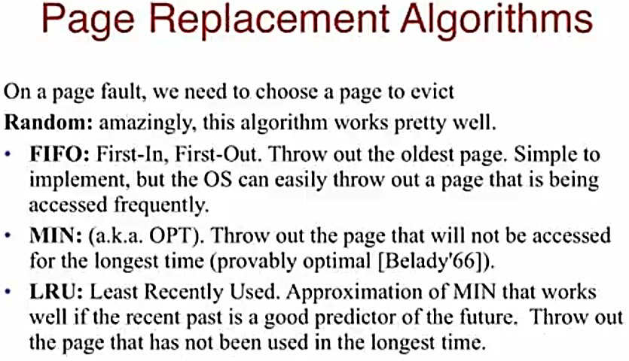

Slide 21
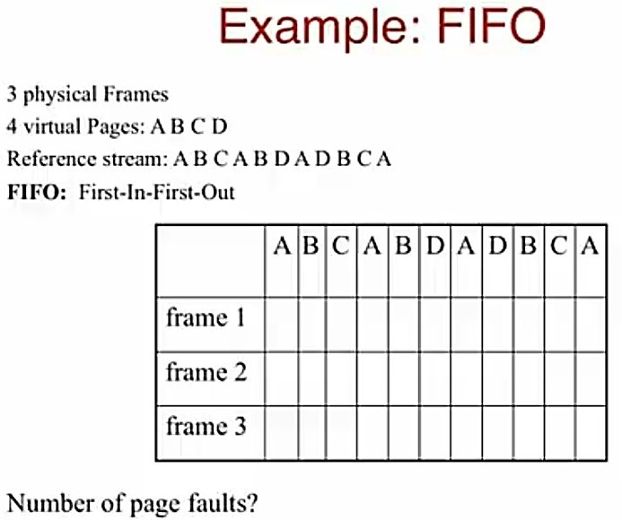
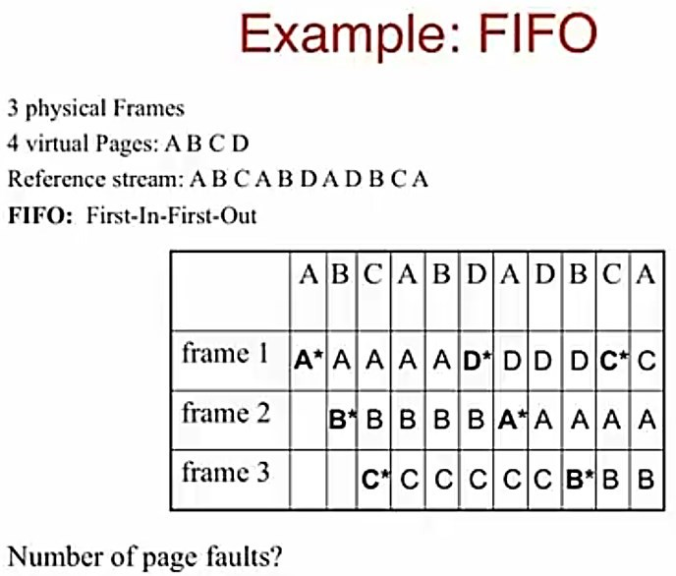





Slide 22
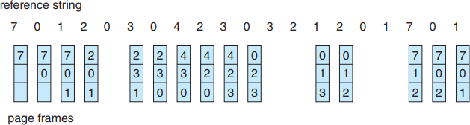















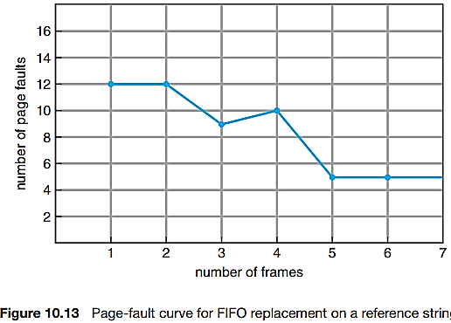



Slide 23
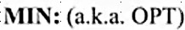
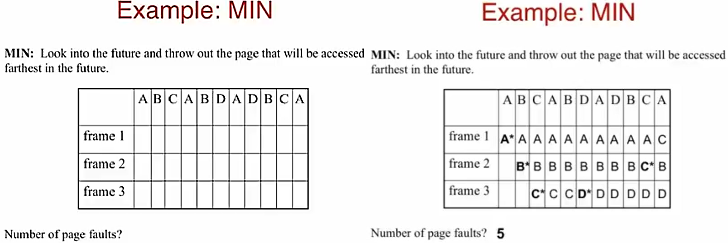


Slide 24
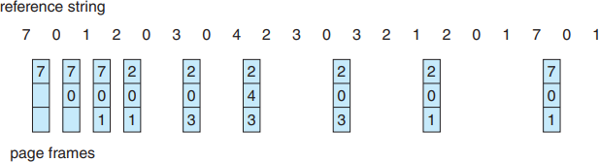

Slide 25
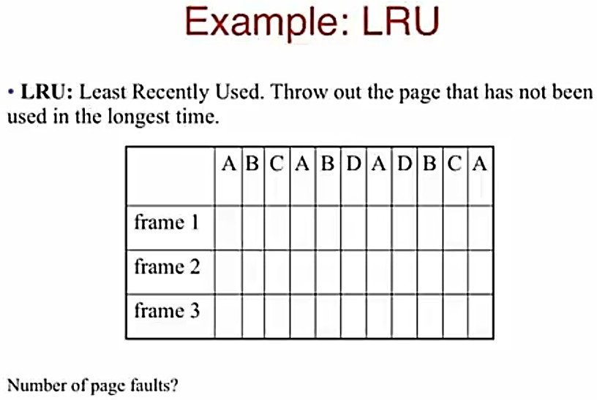
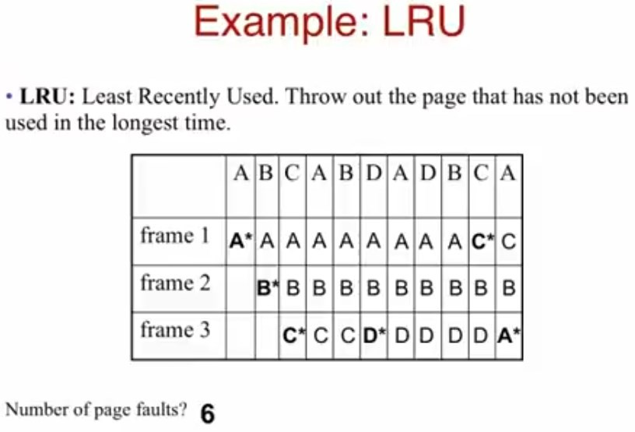



Slide 26
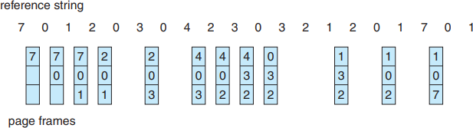

Slide 27
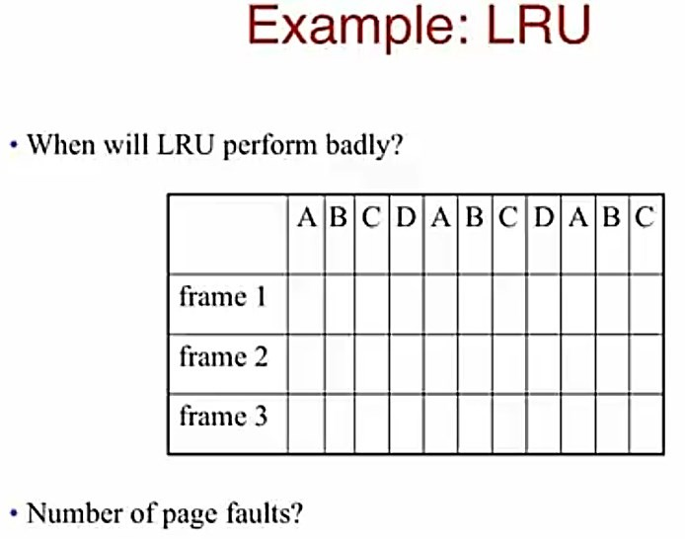


Slide 28


Belady’s anomaly: for some page-replacement algorithms, the page-fault rate may increase as the number of allocated frames increases. We would expect that giving more memory to a process would improve its performance. In some early research, investigators noticed that this assumption was not always true.

Slide 29


Slide 30
Implementation of LRU
2nd Chance
Enhanced 2nd Chance Algorithms

Slide 31
















Slide 32










Slide 33











Slide 34
















Slide 36


Slide 37


Slide 38










Each page is in one of these four classes. When page replacement is called for, we use the same scheme as in the clock algorithm; but instead of examining whether the page to which we are pointing has the reference bit set to 1, we examine the class to which that page belongs. We replace the first page encountered in the lowest nonempty class. Notice that we may have to scan the circular queue several times before we find a page to be replaced. The major difference between this algorithm and the simpler clock algorithm is that here we give preference to those pages that have been modified in order to reduce the number of I/Os required.

Slide 39


Slide 40
Class work: Solve and Submit the end-of- chapter #10 questions on the next slides

Slide 41




Slide 42



Slide 43


